Slide 1
Quantitative Data Analysis I: Hypotheses, Probability, Chi-Square and T-Tests
SI0030
Social Research Methods
Week 5
Luke Sloan

Slide 2
Introduction
Formulating Hypotheses
Selecting Statistical Tests
Understanding Probability (‘p’ values)
Chi-Square Test for Independence
Independent Samples t-Test
Paired Samples t-Test

Slide 3
Formulating Hypotheses I
In Social Science we use the ‘Scientific Method’:
Formulate hypotheses
Collect data
Test hypotheses
Interpret results
To formulate a hypothesis:
Reasonable justification for relationship
Past research or observation
Must be disprovable (Popper’s Falsification Theory)
Dependent variable (x) can be predicted through independent variable (y)

Slide 4
Formulating Hypotheses II
H₀ = The Null Hypothesis
No relationship exists between dependent and independent variables
e.g. there is no relationship between income and age
H₁ = The Alternative Hypothesis
Some relationship exists between dependent and independent variables
e.g. there is a relationship between income and age
How do we test hypotheses?

Slide 5
Selecting Statistical Tests
Remember the levels of measurement (week 1)!
Dependent Variable (y) | Independent Variable (x) | Test to Use | Example | Notes
Nominal or Ordinal | Nominal or Ordinal | Chi-square test for independence | Skateboard ownership (y) and Sex (x) | Expected frequency must not be lower than 5 in any cell
Interval | Nominal or Ordinal | t-test (paired or independent samples) | Income (y) and Sex (x) | Ideally you need 50 in each of the groups that you are comparing
Interval | Interval | Correlation Regression | Income (y) and Age (x) | Relationship must be linear
Note the relationship between dependent and independent

Slide 6
Understanding Probability I
Where does probability come into this?
We use statistical tests to assess whether the hypothesised differences exist and whether they are ‘genuine’ or due to ‘random chance’
e.g. how confident can we be that any difference between male and female salaries is not simply a coincidence?
Remember last week – samples and populations!

Slide 7
Understanding Probability II
Probability is the mathematical likelihood of a given event occurring
What is the probability that I will…
Roll and six on a dice?
Toss a coin and get heads?
Have a birthday in the next 12 months?
Win the lottery?

Slide 8
Understanding Probability III
In statistical tests we measure probabilities using ‘p’ values
A p-value refers to how likely something is to have happened by random chance
For the alternative hypothesis to be accepted, the p-value must be equal to or less than 0.05
This is referred to as the level of STATISTICAL SIGNIFICANCE
P-Value | 0.001 | 0.01 | 0.05 | 0.50 | 0.99
% | 0.1% | 1.0% | 5.0% | 50% | 99%

Slide 9
Understanding Probability IV
For example:
H₀ = There is no relationship between income and sex
H₁ = There is a relationship between income and sex
If we get a p-value of 0.04, what does this mean?
It means that we are 96% confident that any difference in income between men and women is not due to random chance
We therefore reject the null hypothesis and accept the alternative hypothesis

Slide 10
Chi-Square Test for Independence I
Can be used to establish whether there are statistically significant relationships between two categorical variables (nominal/ordinal)
e.g. Is there a statistically significant relationship between skateboard ownership and sex?
In other words, is skateboard ownership INDEPENDENT of sex?

Slide 11
Chi-Square Test for Independence II
The chi-square test is effectively a crosstabulation in which differences between the expected and actual values are measured
Expected = the distribution of responses if there was no relationship
Actual = how the responses are actually distributed
A large discrepancy between the two measures may indicate disproportionality i.e. a statistically significant relationship

Slide 12
Chi-Square Test for Independence III
H₀ = There is no relationship between Sex and Political Party Candidature
H₁ = There is a relationship between Sex and Political Party Candidature
gender * party Crosstabulation
 |  |  | party |  |  | Total
 |  |  | Con | Lab | LD
gender | Male | Count | 933 | 736 | 692 | 2361
 |  | Expected Count | 903.3 | 748.5 | 709.2 | 2361.0
 |  | % within party, 5cat (derived) | 70.1% | 66.7% | 66.2% | 67.9%
 | Female | Count | 398 | 367 | 353 | 1118
 |  | Expected Count | 427.7 | 354.5 | 335.8 | 1118.0
 |  | % within party, 5cat (derived) | 29.9% | 33.3% | 33.8% | 32.1%
Total |  | Count | 1331 | 1103 | 1045 | 3479
 |  | Expected Count | 1331.0 | 1103.0 | 1045.0 | 3479.0
 |  | % within party, 5cat (derived) | 100.0% | 100.0% | 100.0% | 100.0%
Look at the observed and expected counts – what do you think?

Slide 13
Chi-Square Test for Independence IV
Chi-Square Tests
 | Value | df | Asymp. Sig. (2-sided)
Pearson Chi-Square | 4.994ª | 2 | .082
Likelihood Ratio | 5.017 | 2 | .081
Linear-by-Linear Association | 4.288 | 1 | .038
N of Valid Cases | 3479
a. 0 cells (.0%) have expected count less than 5. The minimum expected count is 335.82.
The p-value (Asymp. Sig. 2-sided) is 0.082.
This means that we can only be just under 92% sure that any relationship is not due to chance or error – this is not enough!
The relationship between sex and political party candidature is not significant (x² = 4.99, 2 df., p = 0.08), therefore we accept the null hypothesis.

Slide 14
Independent Samples t-Test I
Can be used to establish whether there are statistically significant relationships between one categorical variable (nominal/ordinal) and one interval variable
e.g. Is there a statistically significant relationship between sex and income?
Uses the mean from each group to establish whether differences are significant at the 0.05 level (do 95% confidence intervals overlap)

Slide 15
Independent Samples t-Test II
The term ‘INDEPENDENT’ refers to the fact that the groups within the categorical variable are independent of each other
i.e. it is not possible for any respondent to be in both groups (samples) at the same time
Think about the height of male and female students in this class – an independent sample t-test would establish whether there is a true (real) difference in height that can be explained by sex

Slide 16
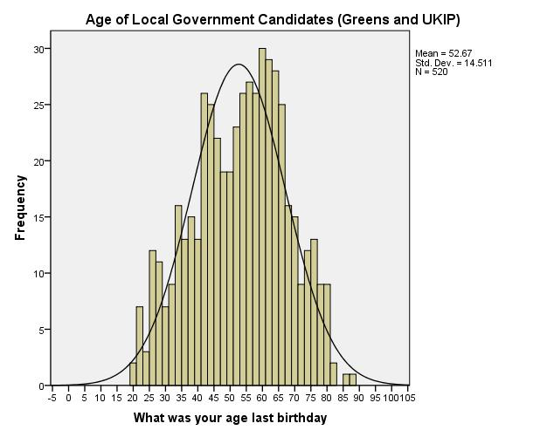
Independent Samples t-Test III
Data must be ‘normally distributed’
Run a histogram to check (normal curve)
Consult Bryman (2004:96)
Samples must have equal (or very similar) variance
SPSS tests for this using Levene’s Test for Equality of Variances
We want this test to be not significant (p>0.05)

Slide 17
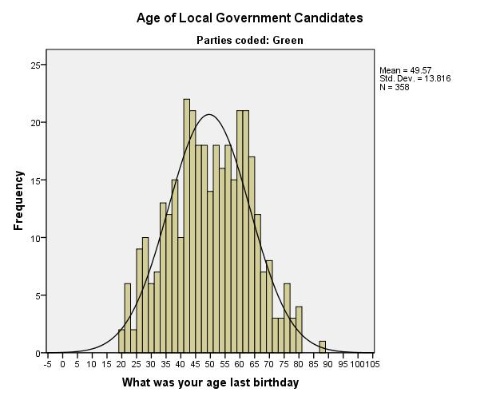
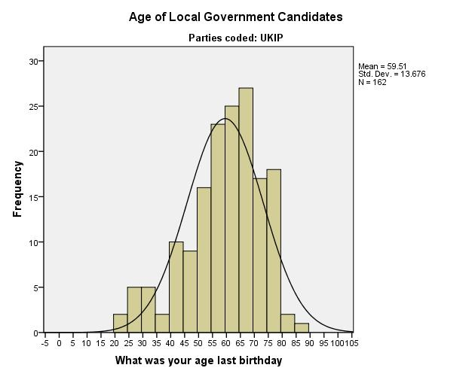
Independent Samples t-Test IV
H₀ = There is no difference in the mean age of UKIP and Green candidates
H₁ = There is difference in the mean age of UKIP and Green candidates
A somewhat subjective judgment of normality…

Slide 18
Independent Samples t-Test V
Notably higher mean age for UKIP candidates
Very similar standard deviations – indicative of similar variance?
Group Statistics
 | Parties coded |  | N | Mean | Std. Deviation | Std. Error Mean
What was your age last birthday |  | Green | 358 | 49.57 | 13.816 | .730
 |  | UKIP | 162 | 59.51 | 13.676 | 1.074
Levene’s Test is NOT SIGNIFICANT (p>0.05) indicating equal variances
The t-test is significant, indicating that the difference in mean age is significant (p<0.05)
Independent Samples Test
 |  | Levene's Test for Equality of Variances |  | t-test for Equality of Means
 |  | F | Sig. | t | df | Sig. (2-tailed) | Mean Difference | Std. Error Difference | 95% Confidence Interval of the Difference
 |  |  |  |  |  |  |  |  | Lower | Upper
What was your age last birthday | Equal variances assumed | .953 | .329 | -7.624 | 518 | .000 | -9.943 | 1.304 | -12.505 | -7.380
 | Equal variances not assumed |  |  | -7.653 | 313.867 | .000 | -9.943 | 1.299 | -12.499 | -7.386

Slide 19
Independent Samples t-Test VI
If Levene’s test is significant (p<0.05) then use the t-test results reported in the second row (‘equal variances not assumed’)
An independent sample t-test was conducted to compare the ages of local government candidates from the Green Party and UKIP. Levene’s test for equality of variance was not significant (f=0.95, p=0.33) and there was a significant difference (t=-7.62, 518 d.f., p<0.05) in the mean age of candidates… [explore the relationship and link to hypotheses]

Slide 20
Paired Samples t-Test
Very similar to an independent samples t-test, but both samples consist of the same respondents (aka repeated measures)
e.g. comparing income at t₁ and t₂ – is there a significant difference?
See Pallant (2005:209) for further detail

Slide 21
Summary
Importance of hypotheses
Applicability of statistical tests and probability
Chi-square test for categorical data
t-test for interval and categorical data
Note: p never equals 0
Generally only p<0.05 or p>0.05
NEXT WEEK: tests for interval data – correlation and simple linear regression

